Slide 1
Education and Taxes
Stacey Smoot
Jake Rose
Andy O’Bryan

Slide 2

Indiana – Hoo Hoo Hoosiers!
Hypothesis:
Zip codes with greater educational availability (defined: number of public schools K-12 and colleges) have higher per capita income and higher percentage of electronic tax fillings with direct deposit returns.
Data Used:
Public Schools – https://www.kaggle.com/carlosaguayo/usa-public-schools
Colleges – https://www.registrar.iastate.edu/sites/default/files/uploads/codebook/bystate.pdf
IRS – https://www.irs.gov/statistics/soi-tax-stats-individual-income-tax-statistics-zip-code-data-soi
Census Data – https://www.census.gov/data/developers/data-sets.html

Slide 3
Considerations
•Some people do not file taxes, which could not be accounted •Data for taxes and census is from 2018 •Data from public schools was 2014 – it is assumed not significant changes •Data from colleges/universities was a recent list, exact year unknown

Slide 4
Taxes
6,211,130 total tax returns filed
5,706,720 electronically
260,120 paper (computer prepared)
3,007,160 paid preparers
108,070 by volunteer preparers
4,205,260 direct deposit returns
11,866,510 persons total
3,783,260 dependents

Slide 5

Hypothesis Result
Hypothesis:
Zip codes with greater educational availability (defined: number of public schools K-12 and colleges) have higher per capita income and higher percentage of electronic tax fillings with direct deposit returns.
Result:
Hypothesis was rejected due to no coloration.

Slide 6
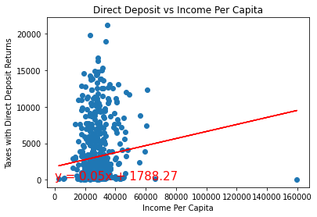
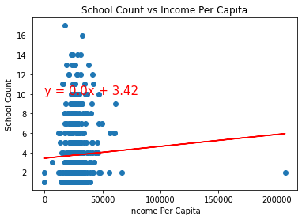

Slide 7
